Slide 1

Intrusion Detection System
Rule-Based, Machine Learning and Neural Network Approaches.
By:- Deobrat Kumar Jha 242IT008
Mitesh Kumar Mandal 242IT020

Slide 2

Introduction to IDS
1
What is IDS?
2
Why is it important?
3
Our Approach
Monitors network traffic for suspicious activities.
Cyber threats are rapidly increasing.
Combines Rule-Based Detection with Machine Learning and Neural Network.

Slide 3
Problem Statement
Challenges
Existing Solutions
Our Goal
High-dimensional data and detecting unknown threats with less time.
Signature-based IDS fails against new threats and Deep Learning based methods may introduce latency due to its complexity and computationally intensive for real time implementation.
Design a Fast, efficient, accurate, and scalable IDS.

Slide 4
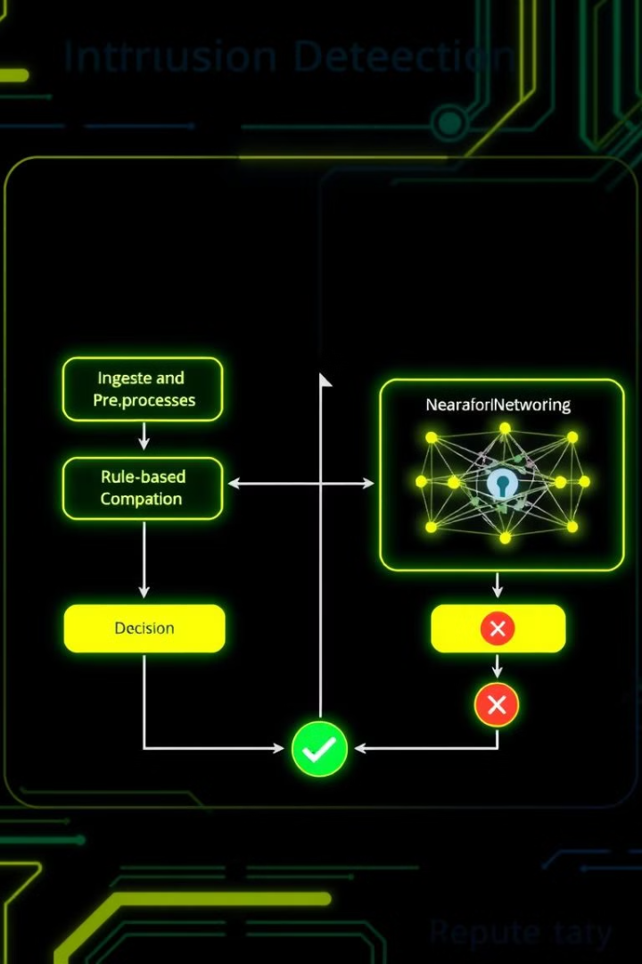
Dataset
CIC-DDoS2019 dataset
Number of Rows : 431371
Number of Features : 78

Slide 5
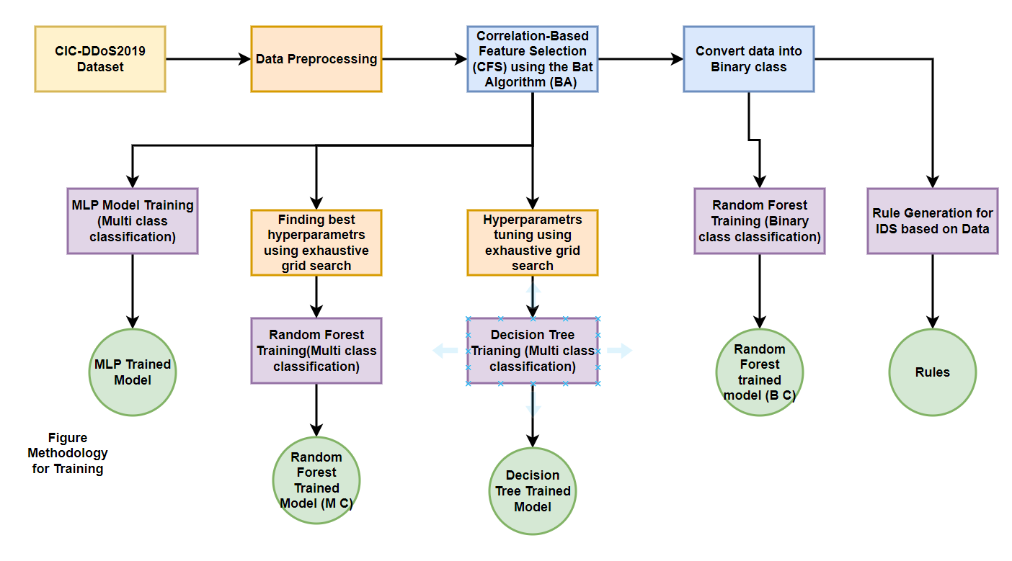
Methodology Overview

Slide 6
Data Preprocessing
Pre-processing Steps
Normalize the Data
We scale the data to bring all values into the same range (usually between 0 and 1).
This helps the model learn faster and perform better because all features are treated fairly.
We have used scaler.fit_transform() function for this.
How it works:-
fit() calculates the minimum and maximum values for each feature.
transform() uses those values to scale each feature.
Encode the Labels
We convert text labels (like "Normal" or "Attack") into numbers (like 0 and 1).
This makes it easier for the machine learning model to understand and process the data.

Slide 7
Correlation-based Feature Selection (CFS)
with Bat Algorithm
Goal: Select the most important features that are highly related to the target (Label) but less related to each other.
This improves model accuracy and reduces unnecessary data.
How It Works:
Correlation-based Feature Selection (CFS):
Measures how strongly each feature relates to the target (Label).
Bat Algorithm:
It’s a nature-inspired optimization algorithm, based on how bats search for food using echolocation.
Benefits:
✅ Reduces dataset size ✅ Speeds up training ✅ Improves detection accuracy

Slide 8

Rule-Based Detection
How it works
Advantages
Matches known attack patterns using security rules.
Fast detection and low computational cost.
Limitations
Cannot detect new, unseen attacks.
Rules are generated using finding correlation b/w feature, feature importance and general concepts of Attacks & its properties.

Slide 9
Multilayer Perceptron (MLP) Model for IDS
Model Architecture :-
1. Input Layer
Accepts network data (features) as input.
2. Hidden Layers
Layer 1:
Fully Connected (fc1): Converts input data into 256 neurons.
Batch Normalization: Speeds up training and stabilizes learning.
ReLU Activation: Introduces non-linearity for better learning.
Dropout (30%): Prevents overfitting by randomly dropping some neurons.
Layer 2:
Fully Connected (fc2): Converts to 128 neurons.
Batch Normalization, ReLU, and Dropout (same as above).
3. Output Layer
Fully Connected (fc3): Produces final output (number of attack classes).
k

Slide 10
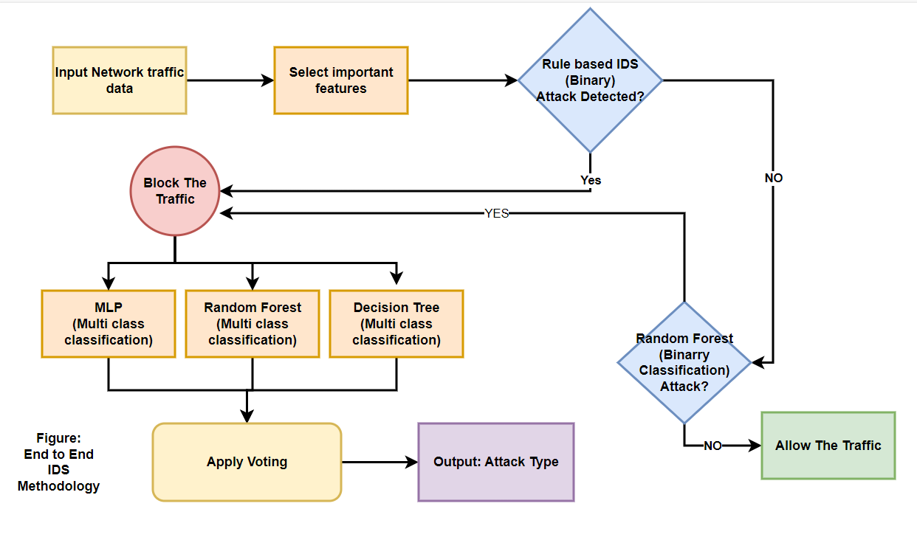
End to End Application Methodology

Slide 11




Novelty of Our Approach
1
Hybrid System
2
Efficient Extraction
3
Improved Detection
4
Better Performance

Slide 12
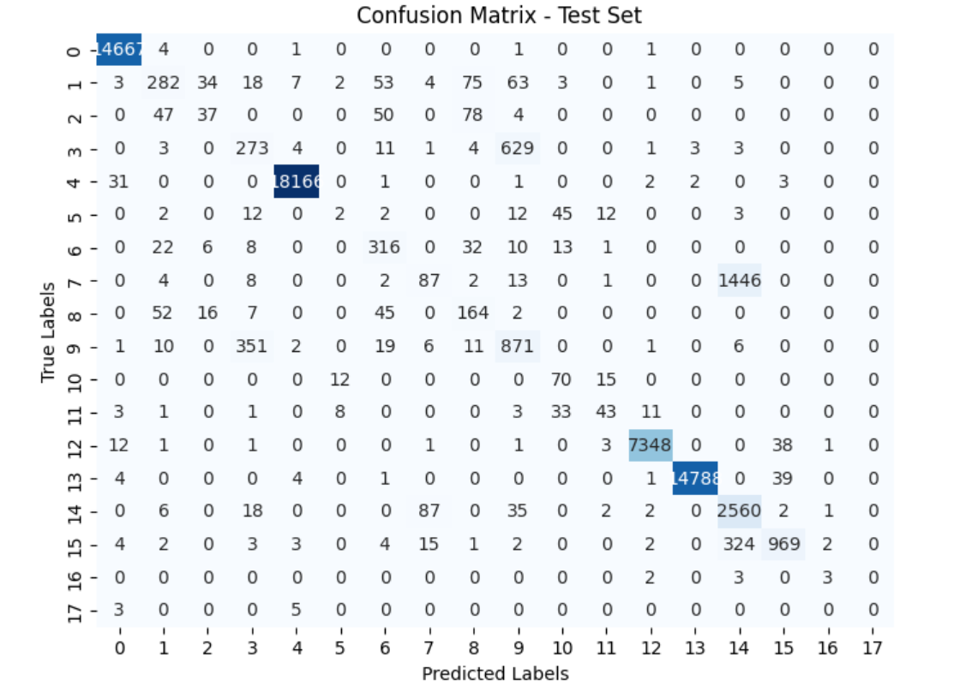
Results (Random Forest)
Test Accuracy: 93.73%
Precision : 93.47%
Recall: 93.73%
F1 score: 92.98%
ROC-Curve Score: 99.81%

Slide 13
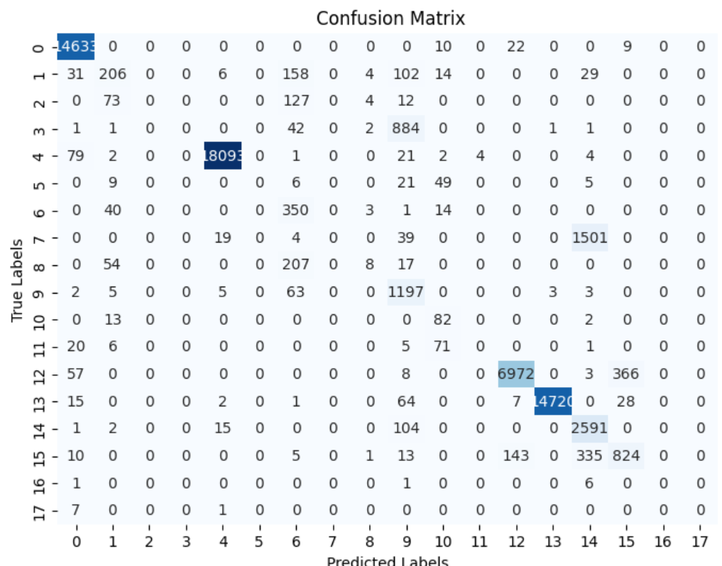
Results (MLP)
Test Accuracy: 92.29%
Precision : 90.19%
Recall: 92.29%
F1 score: 90.73%
ROC-Curve Score: 98.90%

Slide 14
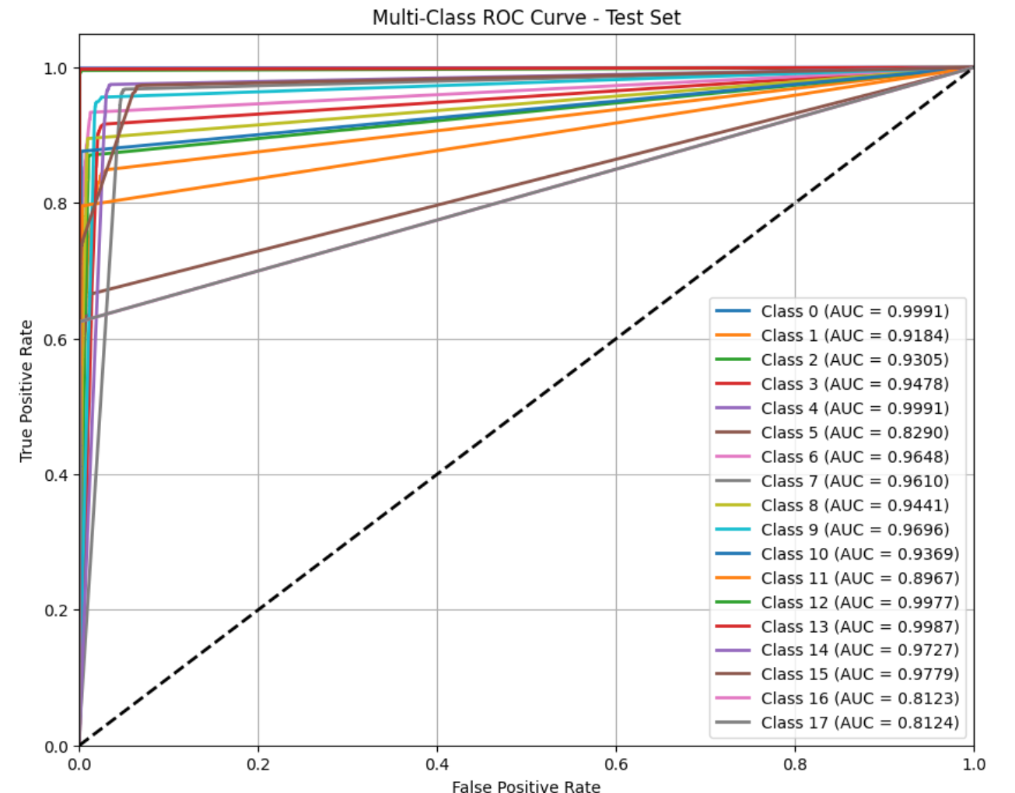
Results (Decision Tree)
Test Accuracy: 93.45%
Precision : 93.14%
Recall: 93.45%
F1 score: 92.74%
ROC-Curve Score: 99.32%

Slide 15
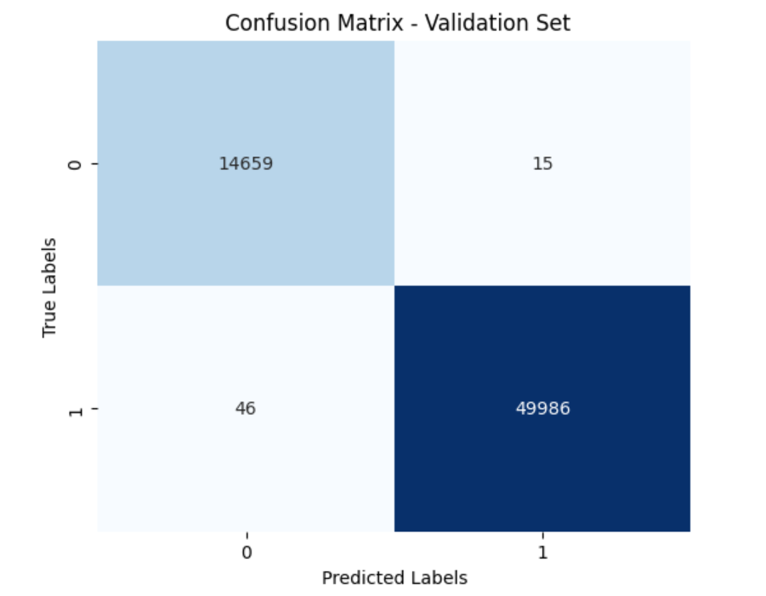
Results (Random Forest Binary classification)
Test Accuracy: 99.93%
Precision : 99.97%
Recall: 99.94%
F1 score: 99.95%
ROC-Curve Score: 99.99%

Slide 16
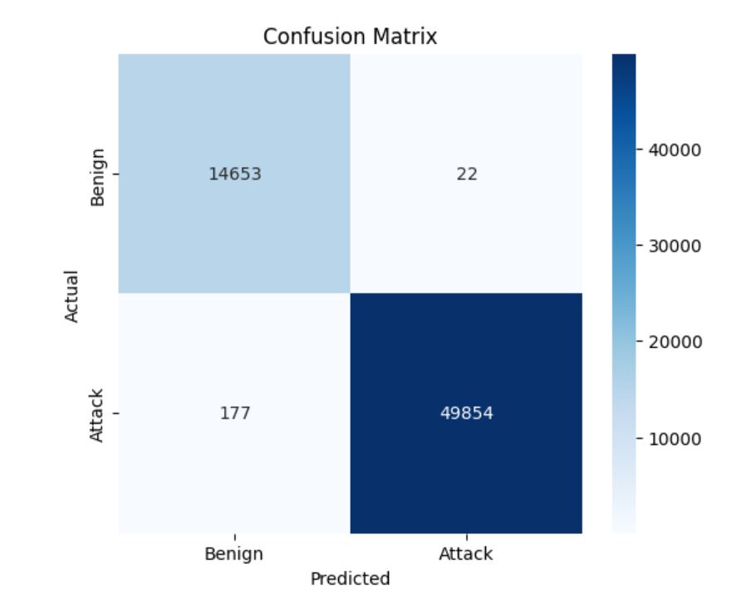
Results (Rule Based Binary classification)
Test Accuracy: 99.69%
Precision : 99.96%
Recall: 99.65%
F1 score: 99.80%
ROC-Curve Score: 99.75%

Slide 17
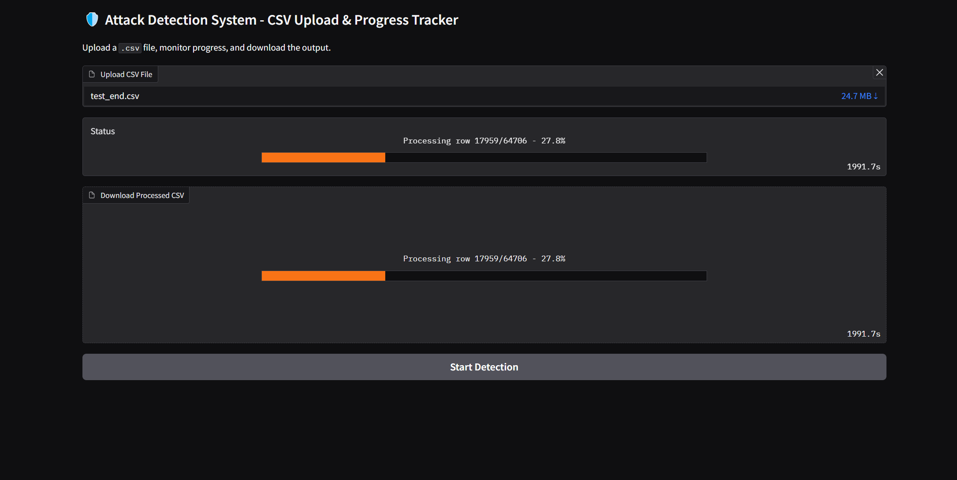
End to End UI
Thank You

